Slide 1

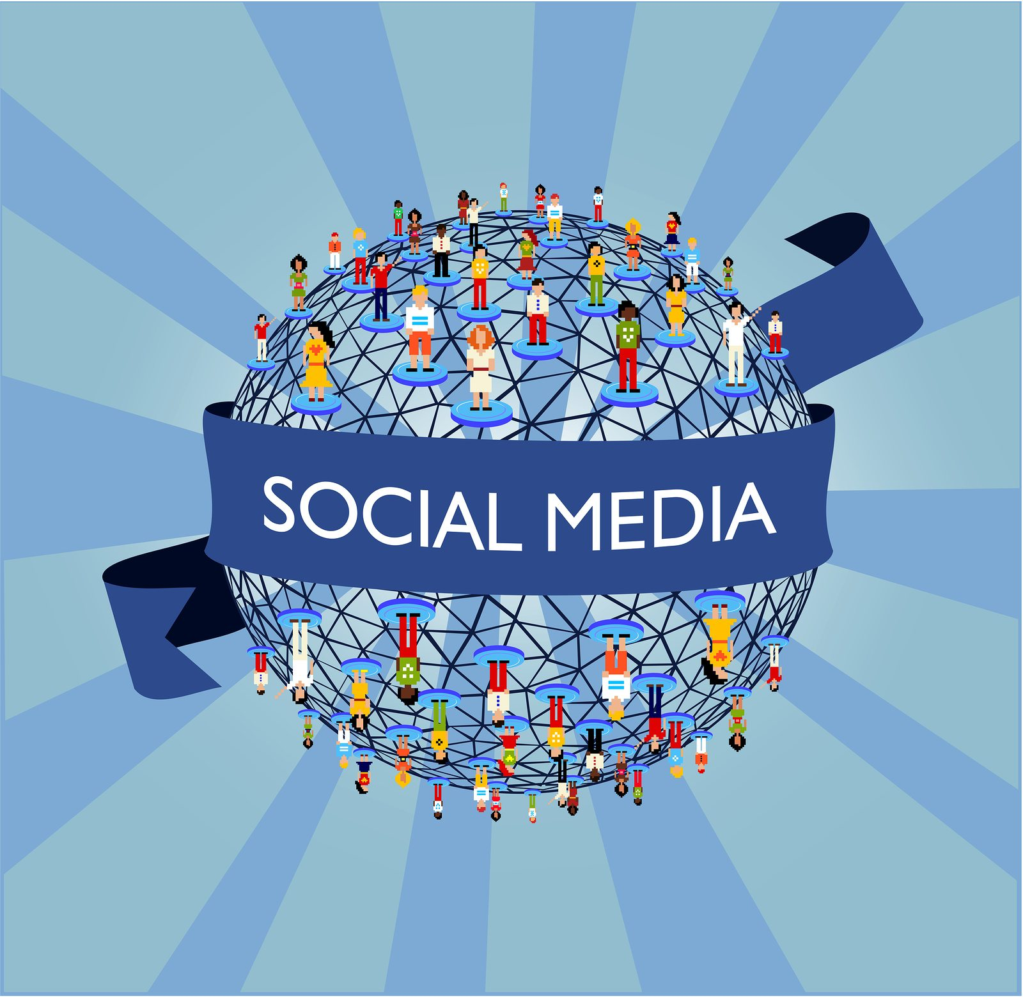
TEAM GUIDE: V. LAKSHMI NARAYANA TEAM MEMBERS: CH.KAVYA B. HEMALATHA Y. ANUPAMA B. YASASWINI
Presentation On Impact Of Social Media On Youth

Slide 2

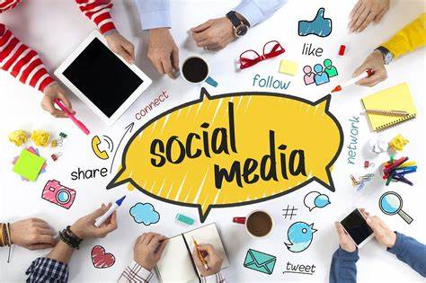
CONTENTS:
Introduction To The Social Media
Objective Of The Survey
Questionnaire
Log Book Entries Images
Batch Members Report On Survey & Image Proofs
Conclusion

Slide 3
Introduction
Now a day’s social media has been the important part of everyone’s life from shopping to electronic mails, education and business tool.Social media plays a vital role in transforming people’s life style. Social media includes social networking sites and blogs where people can easily connect with each other. Since the emergence of these social networking sites like Twitter and Facebook as key tools for news, journalists and their organizations have performed a high-wire act. These sites have become a day to day routine for the people.
Social media has been mainly defined to refer to “the many relatively inexpensive and widely accessible electronic tools that facilitate anyone to publish and access information, collaborate on a common effort, or build relationship” Social media is defined as websites and applications that enable users to create and share content or to a participate in social networking. It is the one of the most modern and favorite form of the social media including many features and social-characteristics in it.

Slide 4
What is social media?
Social media refers to interaction among the people in which they can create, share or exchange information and ideas in virtual communities and networks.
“Social” refers to instinctual needs humans have to connect with other humans.
“Media” refers to what we use to make connections with other humans .
“Social media”-media used for social interaction. Social media is the use of electronic and internet tools for the purpose of sharing and discussing information and experiences with an online community.
The “social” in social media implies a conversation. The difference between social media and the TV is that with the latter, viewers seldom engage with the program-makers of the show that they are watching. Only in very recent time have program makers expanded into the world of the social media. social media are interactive internet-based applications, and user generated content, such as text posts or comments, digital photos or videos and data generated through all online interactions, is the lifeblood of social media.

Slide 5
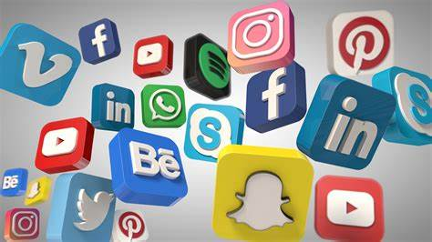
Tools Of Social Media
Social media is the collective of online communications channels dedicated to community-based input interaction, content sharing and collaboration.
Websites and applications dedicated to forums, microblogging, social networking, social bookmarking, social curation, and wikis are among the different types of the social media.
Some of the popular social media tools/websites
WhatsApp
Twitter
Face book
Google+
Snapchat
Instagram
Linked in

Slide 6
Positive Effects Of Social Media On Youth
Social media helps youngsters to stay connected with each other
Useful information can be exchanged over social networking sites.
Information can be directly sent to large number of people easily.
Increase a general knowledge and awareness of students.
Helps in avoiding boredom.
A local business person may expand this business over websites.
Targets a wide audience, making it a useful and effective recruitment tool.
Helps in conversation around the world.
The social networking websites can be accessed from any part of the globe.
Saves time and cost by facilitating faster communication.
Develop social skills, reading and writing skills
Develop concentration
Make independent, Provide self directed learning

Slide 7
Negative Effects Of Social Media On Youth
Eye problems : prolonged use of display screens may weaken eye sight
Addiction: Internet shopping , online chatting can be addictive
Effect on health: sitting all day in front of laptops/computers may disturb body metabolism
Reduction in physical activities
Social distrust
Lack of interpersonal skills : youth often ignore the importance and the appropriate behaviour
Spend less quality time with your beloved ones
Effects on physical fitness
Misinformation
Security and privacy
Increased the Stress
Adverse effects on Sleep
A waste of time

Slide 8
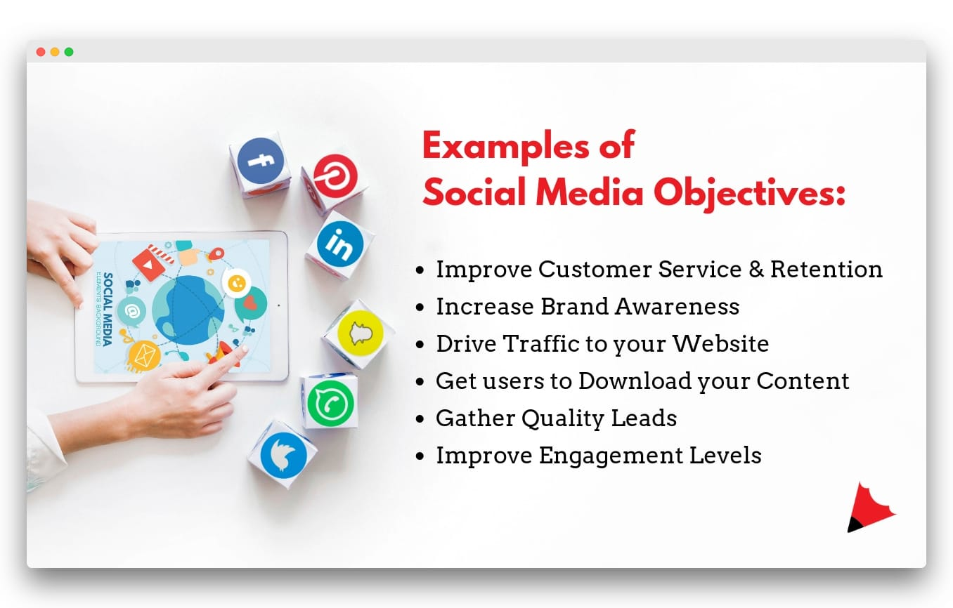

Slide 9
Objectives of Social Media
As stated before, Social Media plays a crucial role in the creation as well as the exchange of content. However, apart from this, the Social Media platform aims to serve and fulfill its core objectives along with the objectives of the business or the brand using social media as a tool to market their brand.
The First and the Foremost aim of Social Media like any other media tool is to Educate Society. One of the most important objectives of any media tool is to take on the initiative to educate our society as a whole, to build our society up, and spread awareness.
This objective is not just applicable to mainstream media but also applies to Social Media. It rather should take more priority as it is such a tool which connects everyone in today’s time, all around the globe, just through the click of a button; easily accessible through the internet, websites, and application designed for just the same.

Slide 10
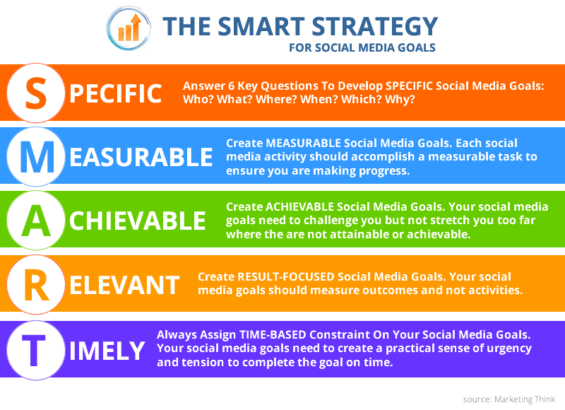

Slide 11
One can conduct surveys through social media and ask anyone in their reach to voice their opinions. Social media has made connectivity so easy that even though people are not within each other’s immediate reach, they are still connected and can easily voice their own opinions as well as encourage others to state their opinions.
Society can not only be educated about products but also on topics relevant to society. Apart from advertisements, a consumer can explore, analyze, and make informed decisions about products they are interested in acquiring. That way they can make an informed purchase that is perfect for their specific requirements.
This is further encouraged and facilitated by the fact that nowadays people can make such informed decisions by also analyzing the product reviews by other consumers and have an insight as to what should or shouldn’t be bought. Social Media also helps promote and stabilize the buyer-seller relationship and helps the buyer to compare the prices of similar products across several websites.

Slide 12
Questions
How Much Should They Use Social Media?
On average, teenagers are spending about 9 hours a day in front of a screen. According to Monitoring the Future,spending two hours on social media has shown to contribute to unhappiness and anxiety. Parents are therefore advised to limit social media to 60-90 minutes a day. It’s important that the other hours are spent face-to-face with friends, doing sports or other activities, studying and spending time with family. This balance has shown to produce better students and happier kids overall.
Does Social Media Have Any Benefits?
There are some positive effects of social media. Teens are social by nature, so making socialization easy and immediate can be beneficial. It can also be helpful for those who have social anxiety or struggle with social skills. In addition, marginalized groups – such as LGBTQ teens and those struggling with mental health – can find friendship and support on social media. Those connections can be critical and make a real impact.

Slide 13
What Happens if They Spend Too Much Time on Social Media?
There are several warning signs to look for that may indicate your tween is on social media too much:
•They withdraw from face-to-face interaction
•They have consistent anxiety or stress
•They avoid responsibilities like homework or chores
•They feel overwhelmed by normal routines
•Their academic effort decreases and grades begin to slip
•They avoid talking to people next to them by looking at their phone
•Social media creates conflicts in their relationships
If you notice any of these behaviors in your teenager, it might be time for a serious conversation about social media use.
How does social media affect mental health?
Again, there have been numerous studies about social media’s effects on mental health. Although there are negative impacts, such as the increased risk of anxiety, depression, negative body image, and cyberbullying, there are also some positives (as we’ll see). However, either way, it’s important for online users to understand and take care of their mental health.

Slide 14
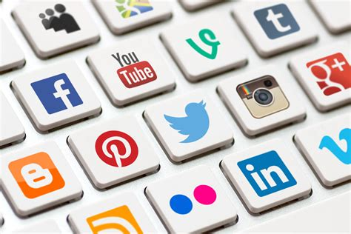
How many people use social media? This is one of the most popular social media FAQs, and for good reason. According to figures from Statista, nearly 50% of the world’s population uses social media. Data from 2020 shows that 3.81 billion people use some form of social network. When you consider that there are just over 4.5 billion internet users, this is a staggeringly large proportion. What are the top 10 social media apps? As we explored in our post on the top 10 social media apps, this is a hard question to answer. There are so many metrics we could use, particularly given the ways different countries approach social media. However, based on the number of users worldwide, Facebook, YouTube, and WhatsApp make up the top three sites.

Slide 15

1.How often do you spend on social media? 2.What time they are spending on social media? 3.Impact of social media on their sleep? 4.What are the personal benefits of using social media? 5.Why do they are use these social networking sites? 6.How much personal information they share on their social media? 7.How dependent are they on technology? 8.How do they feel without using the social media for a long time? 9.How many days they can avoid their social media? 10.How useful is social media for learning?

Slide 16
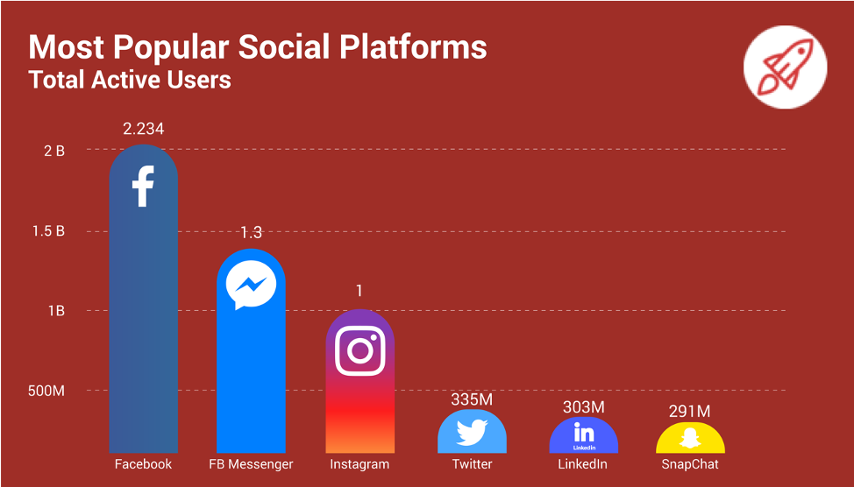

Slide 17
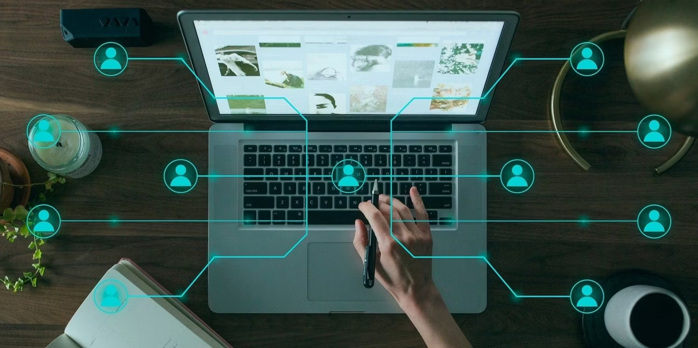
What are the personal benefits of the social media? Social media often gets a bad rep these days, with many feeling that they spend too much time on the platforms. Some find them toxic and full of arguments, whereas others find it creepy to be constantly connected to everybody.

Slide 18

Social Media Allows Instant Online Discussion
Social Media Promotes Knowledge Sharing
Keep In Touch With Old Friends on Social Media
Social Media Reduces stress

Slide 19


Social Media Promotes Free Learning

Slide 20
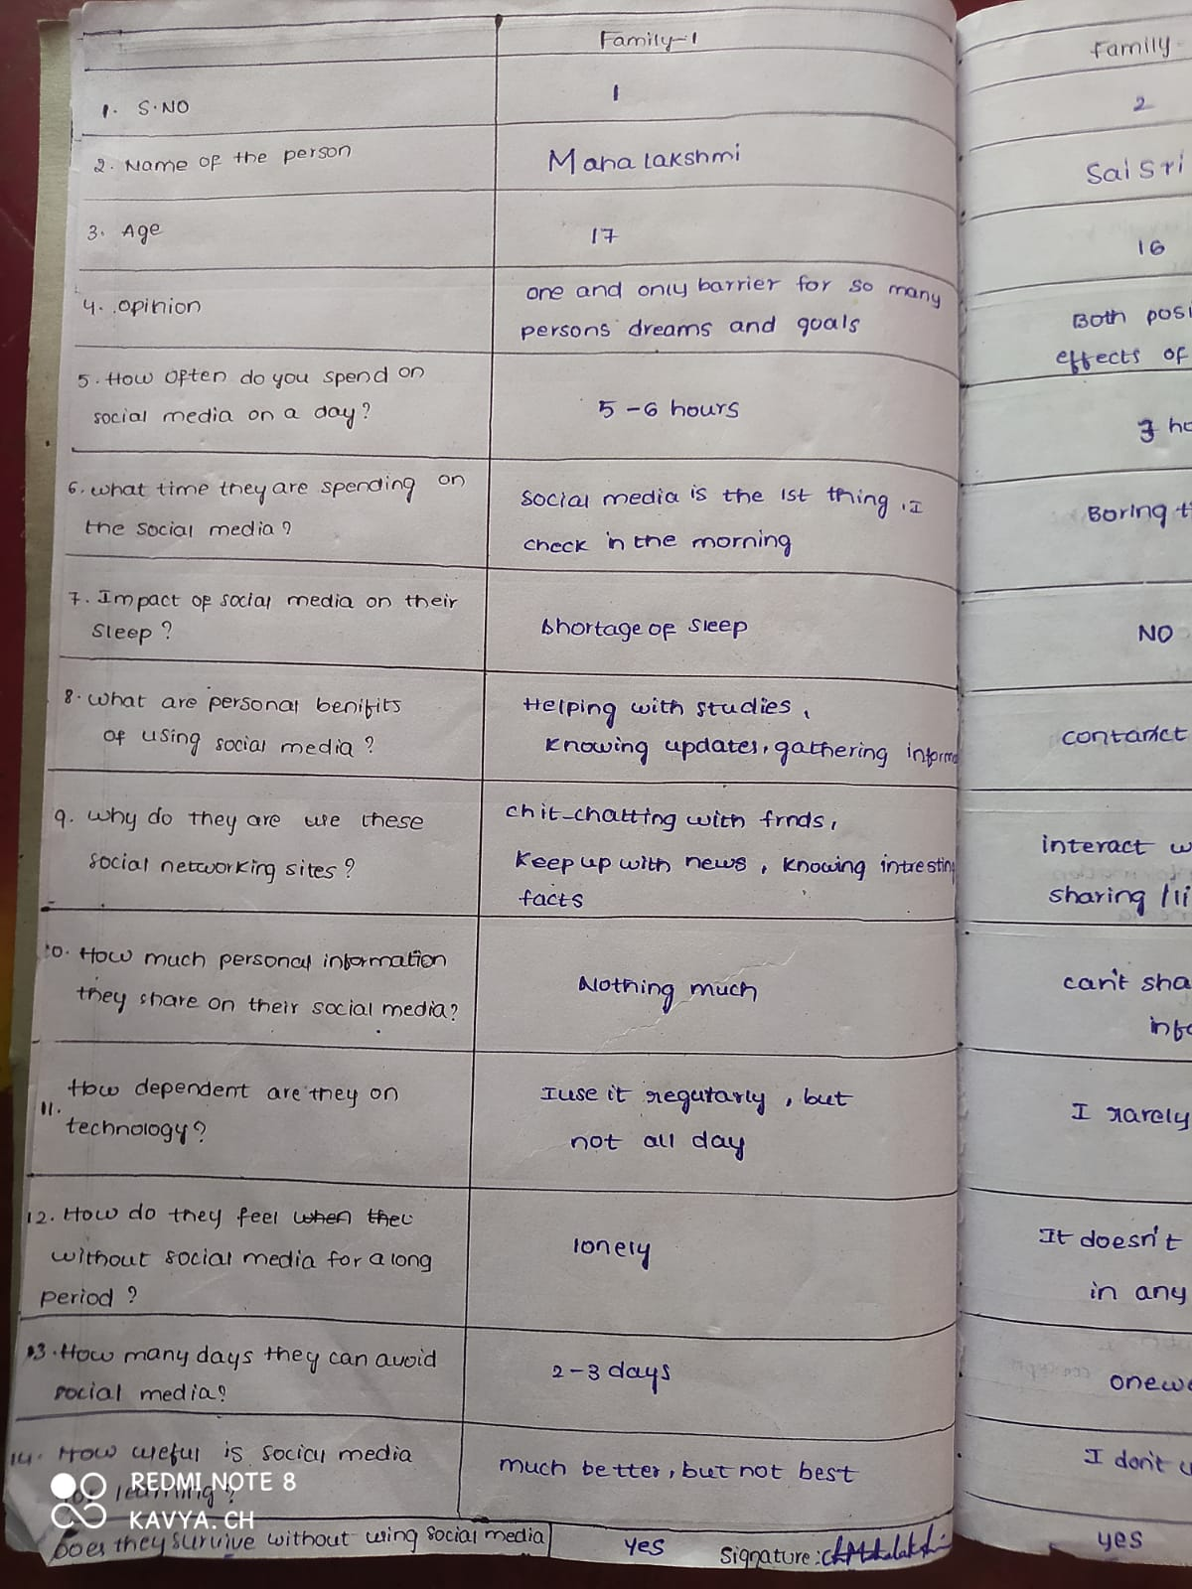
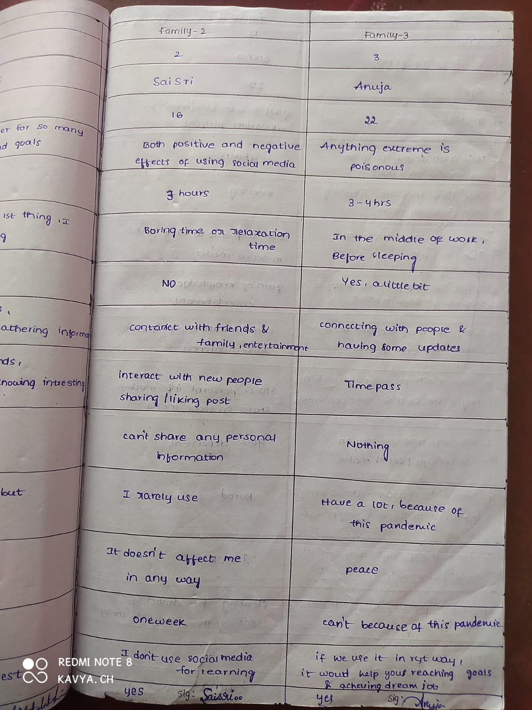
Log book entries images:

Slide 21
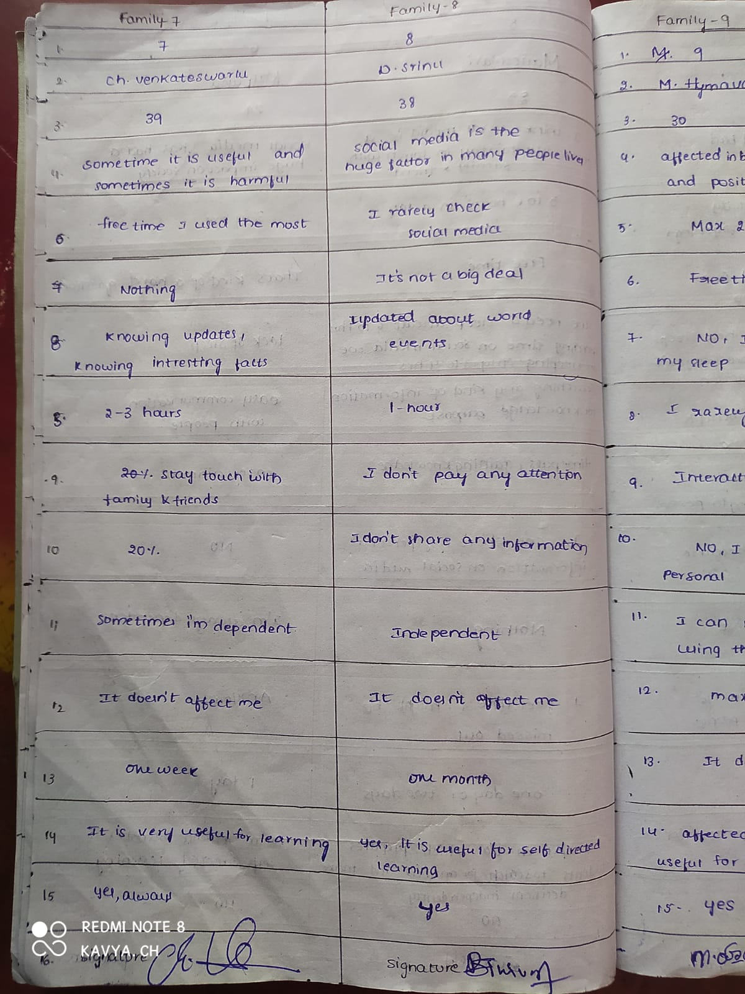
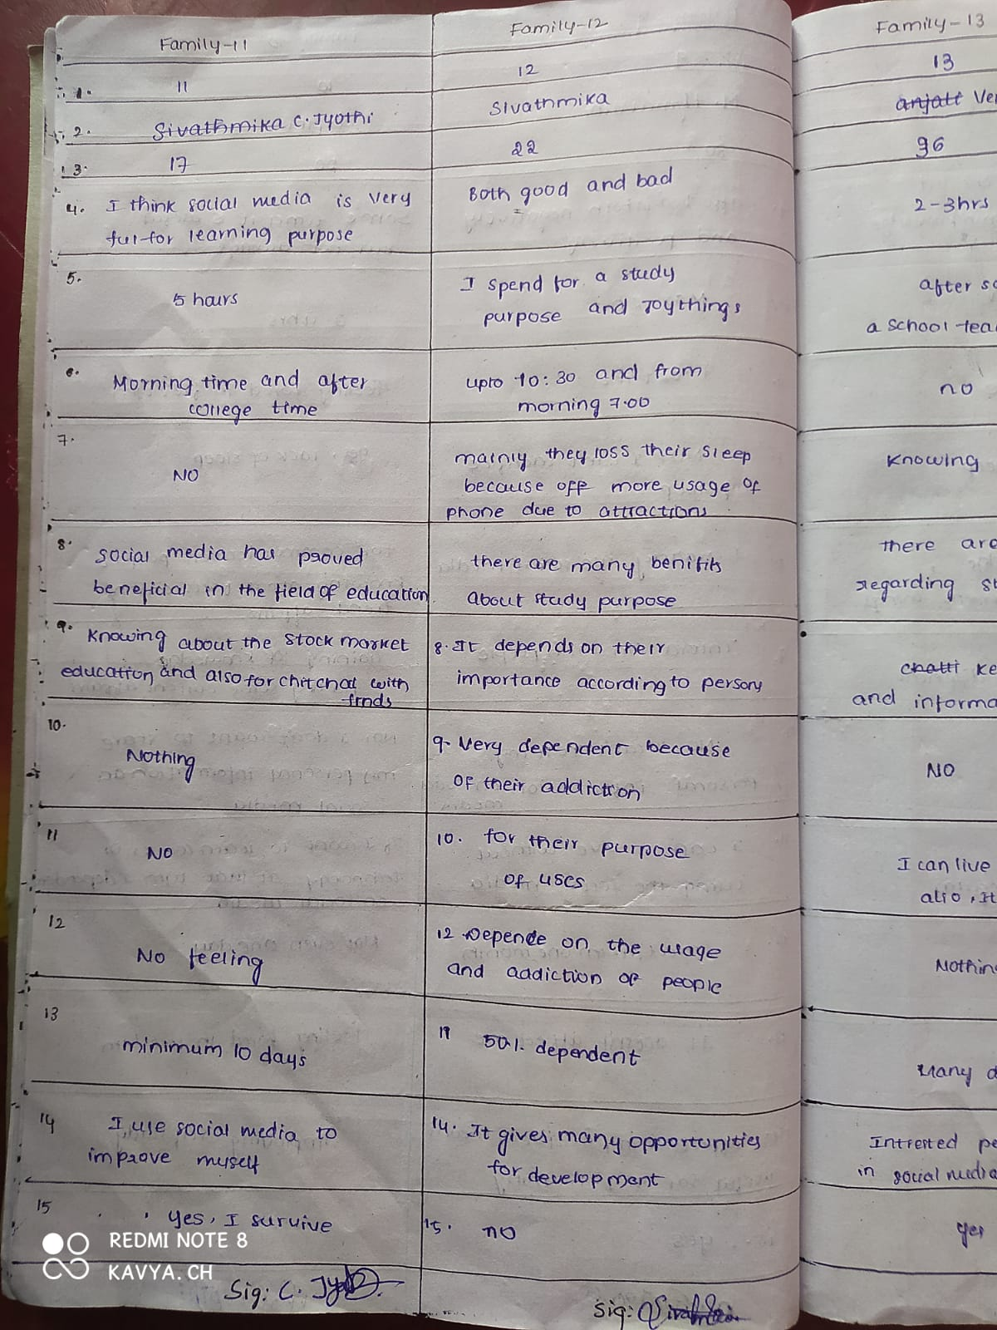

Slide 22
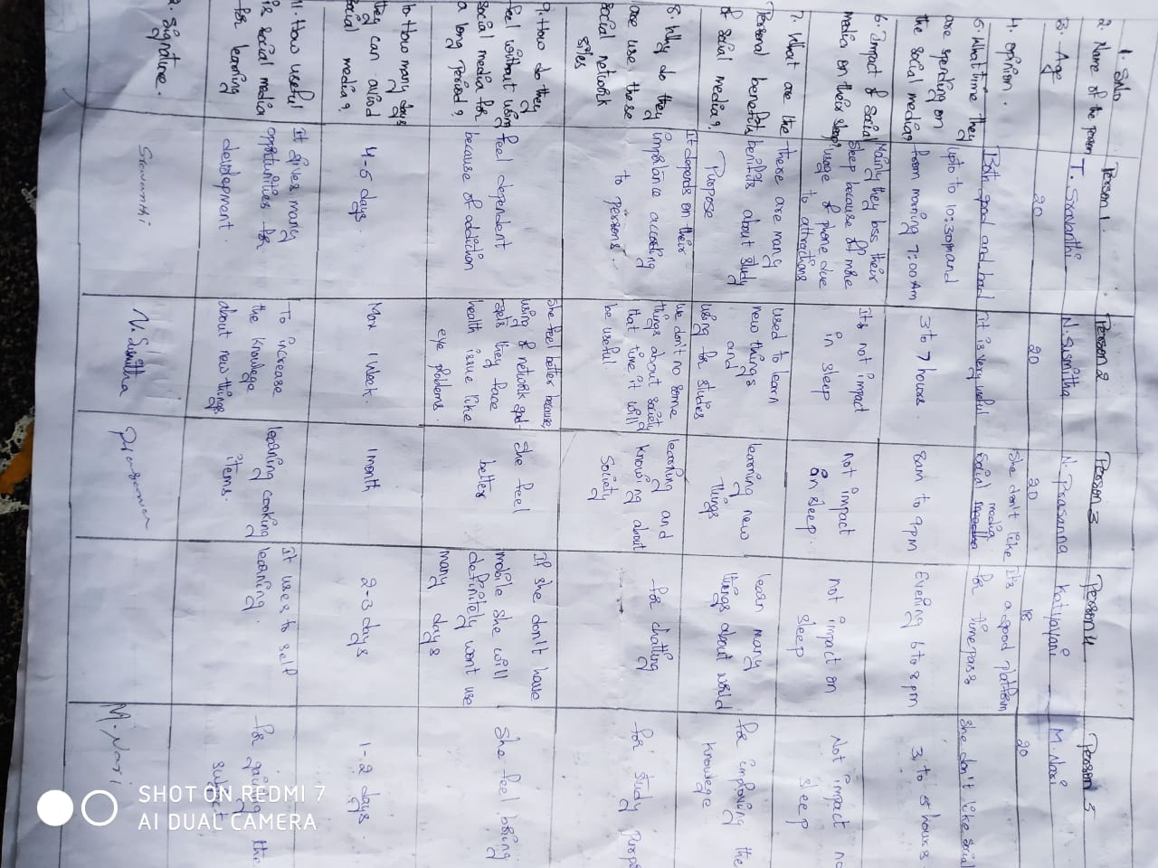

Slide 23
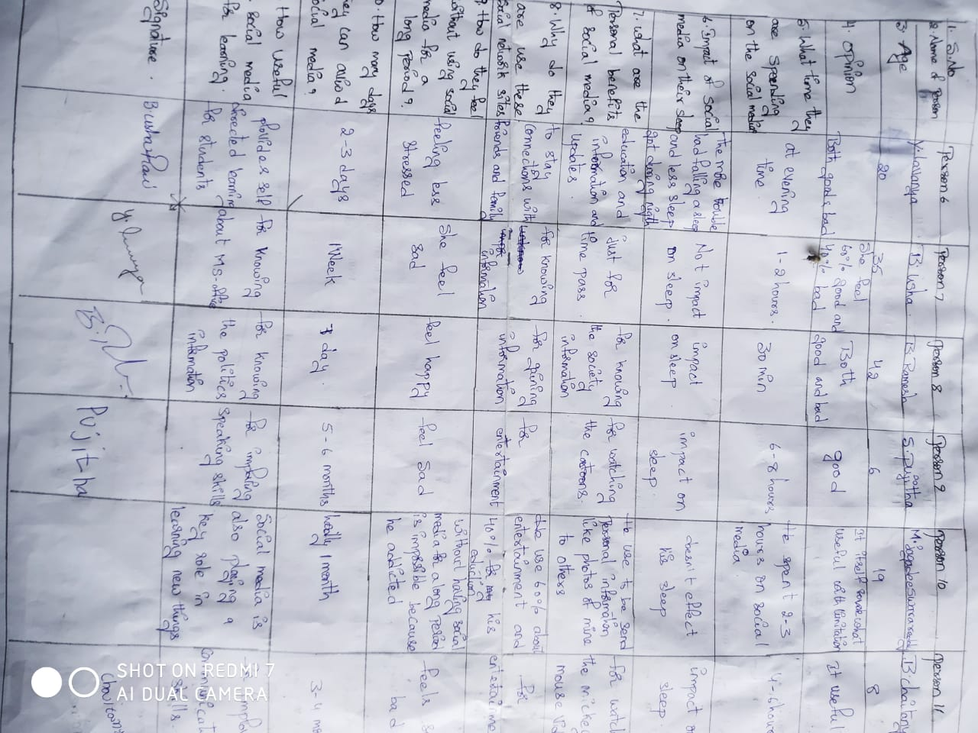

Slide 24
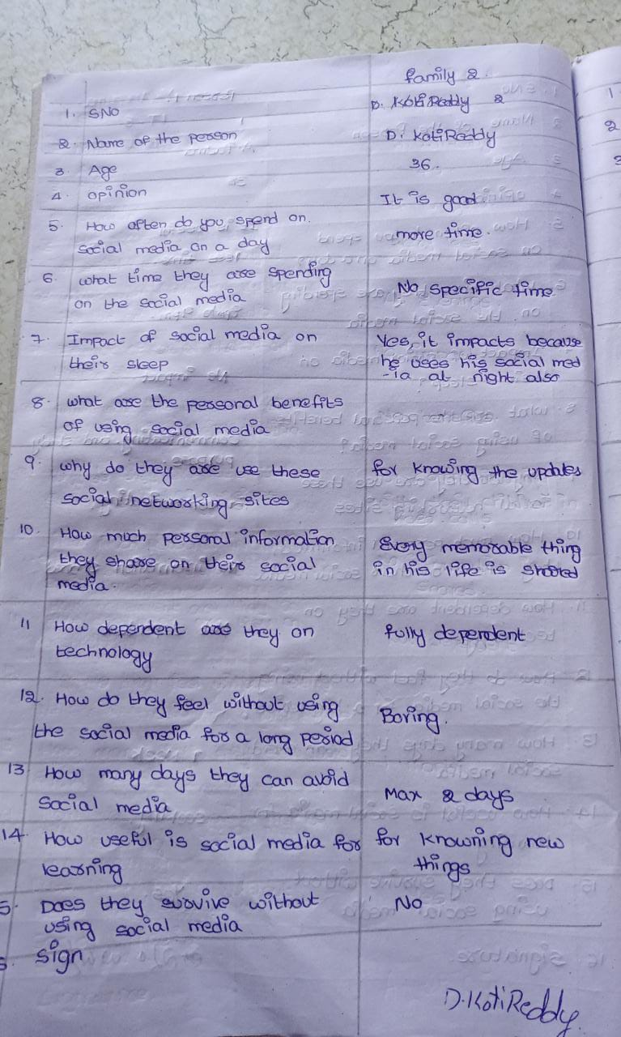
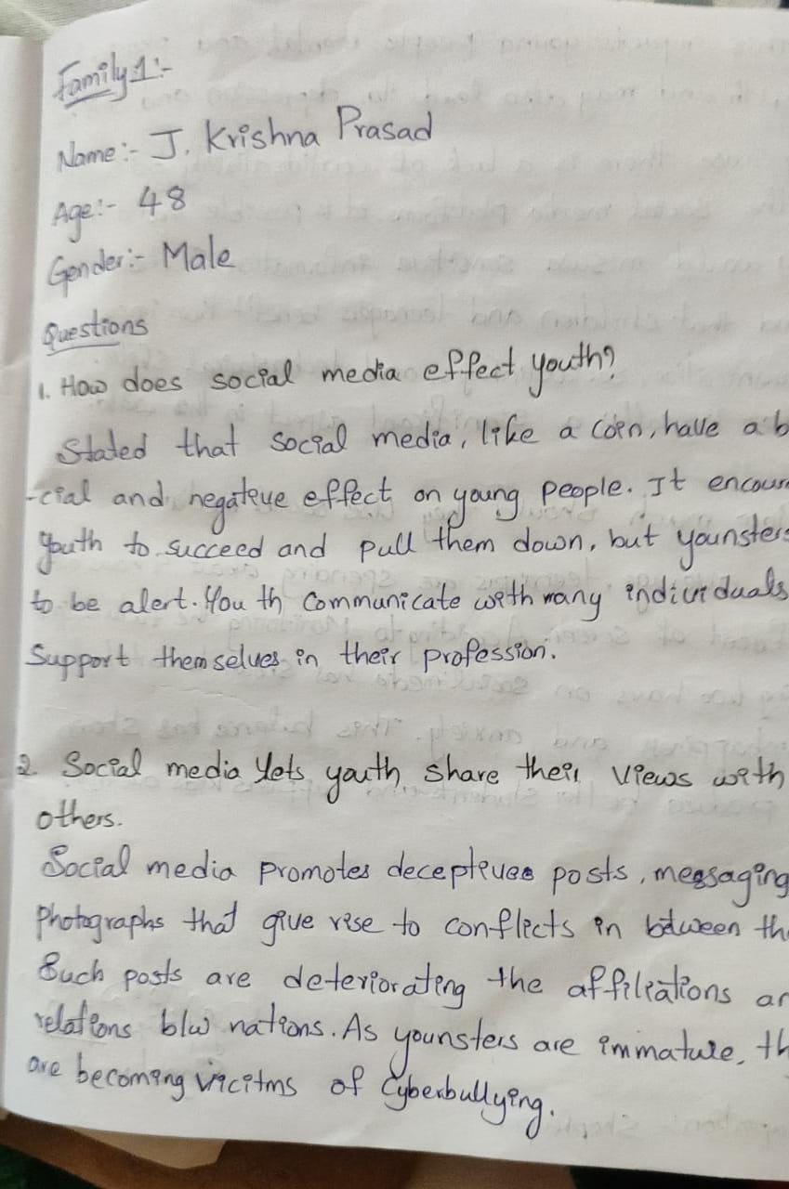

Slide 25
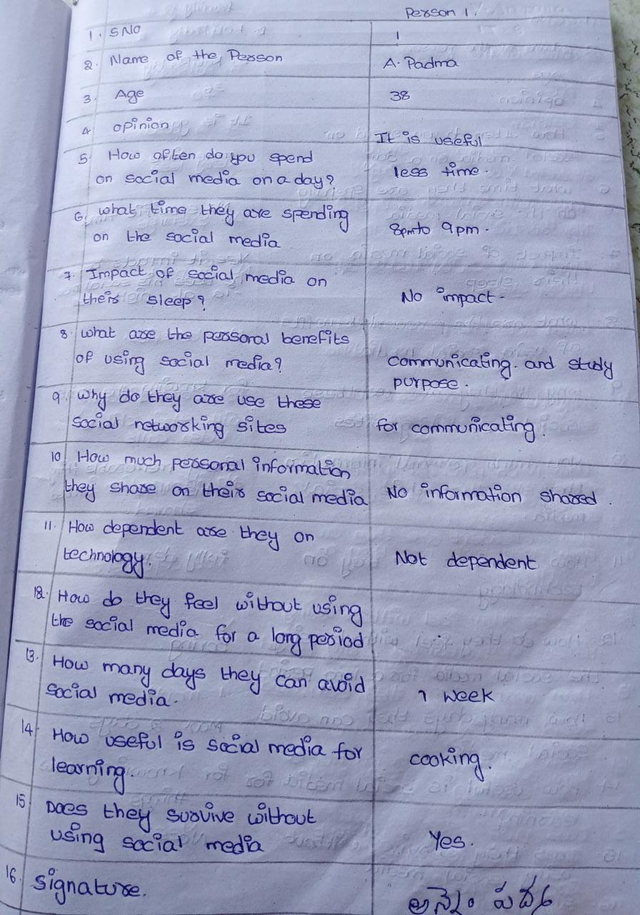
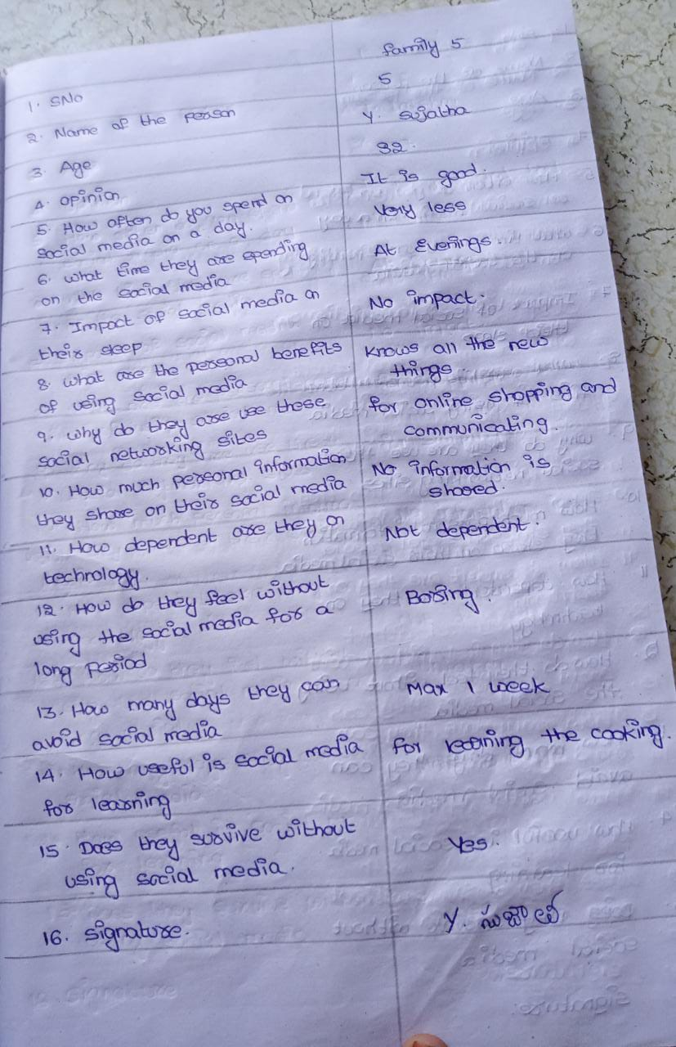

Slide 26
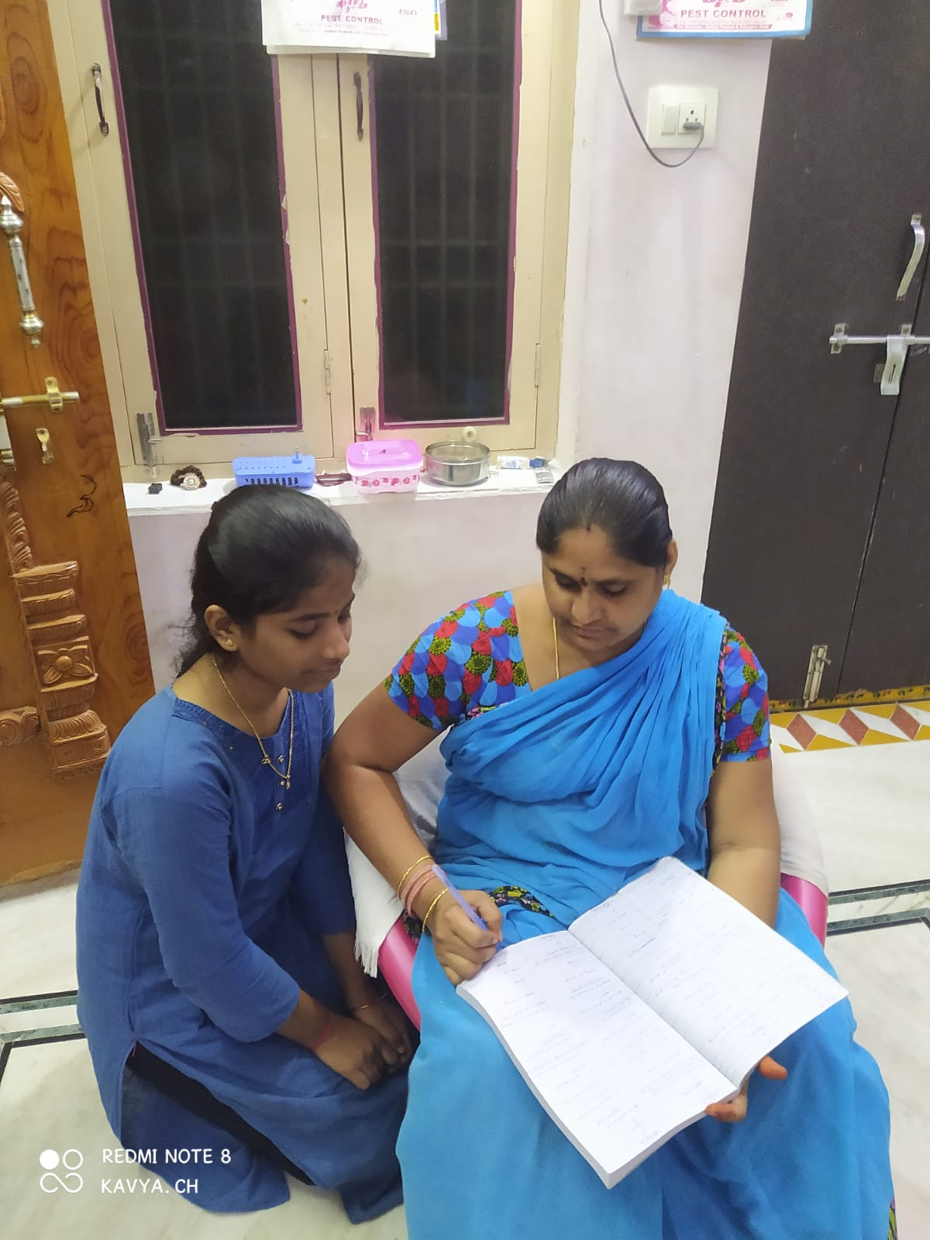
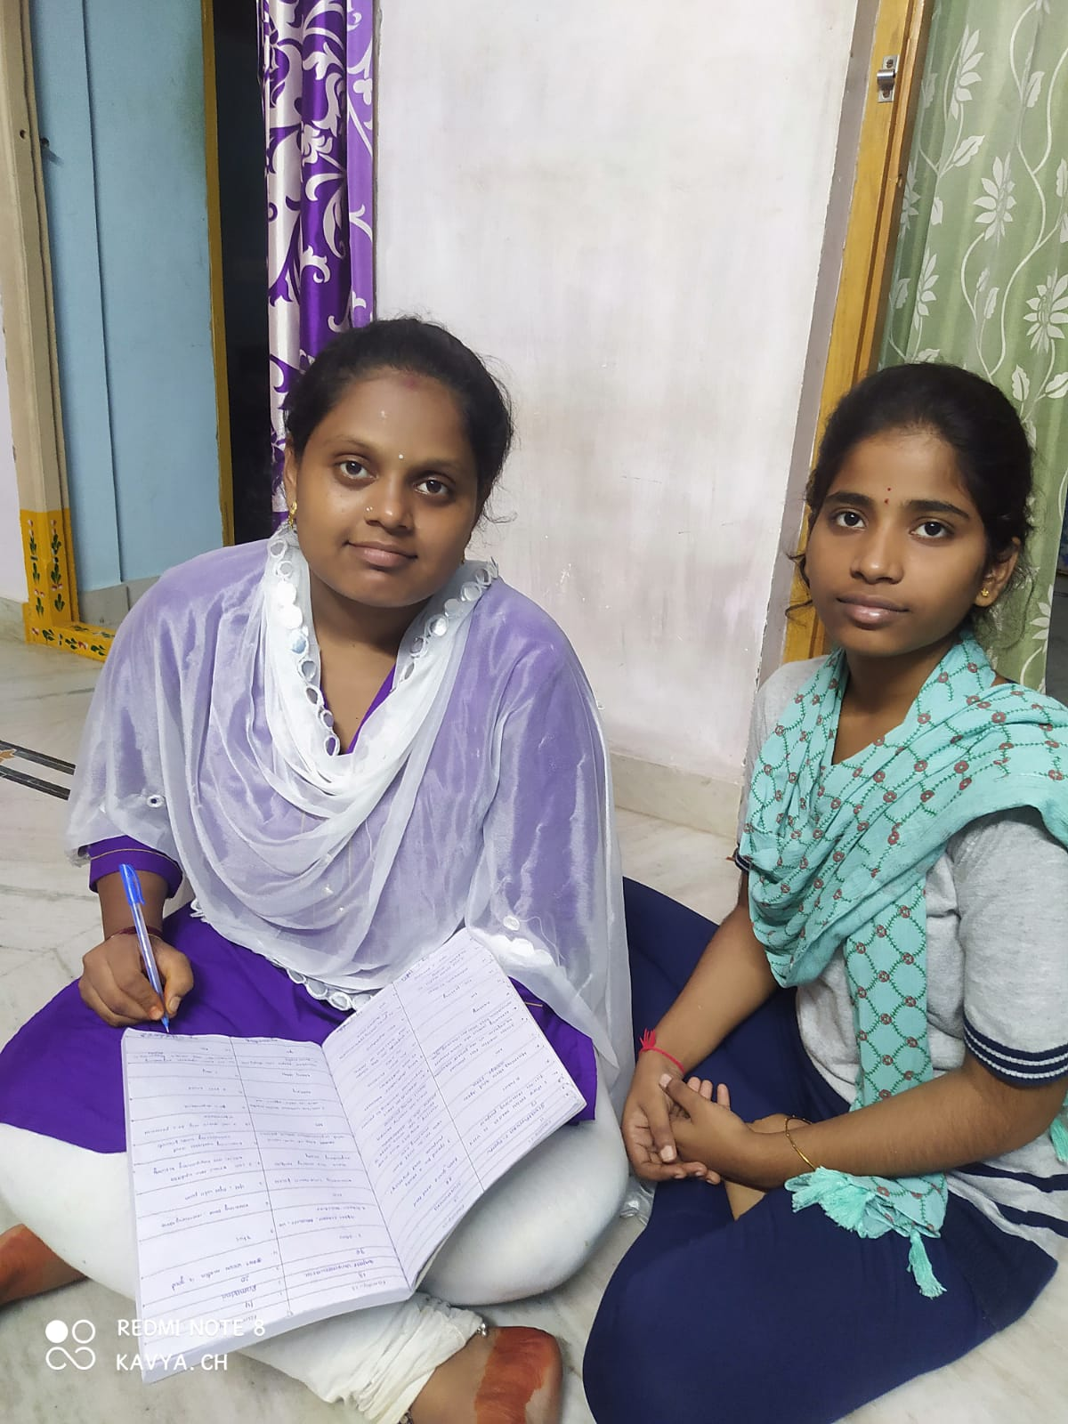
Batch members report on survey and image proofs:

Slide 27
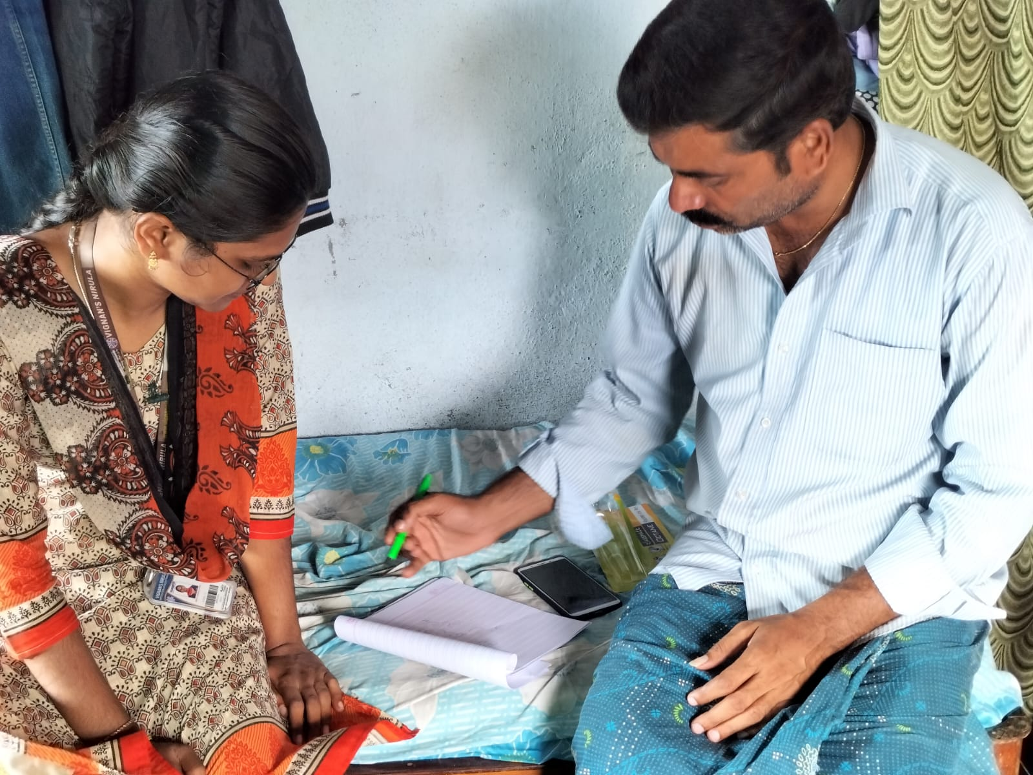
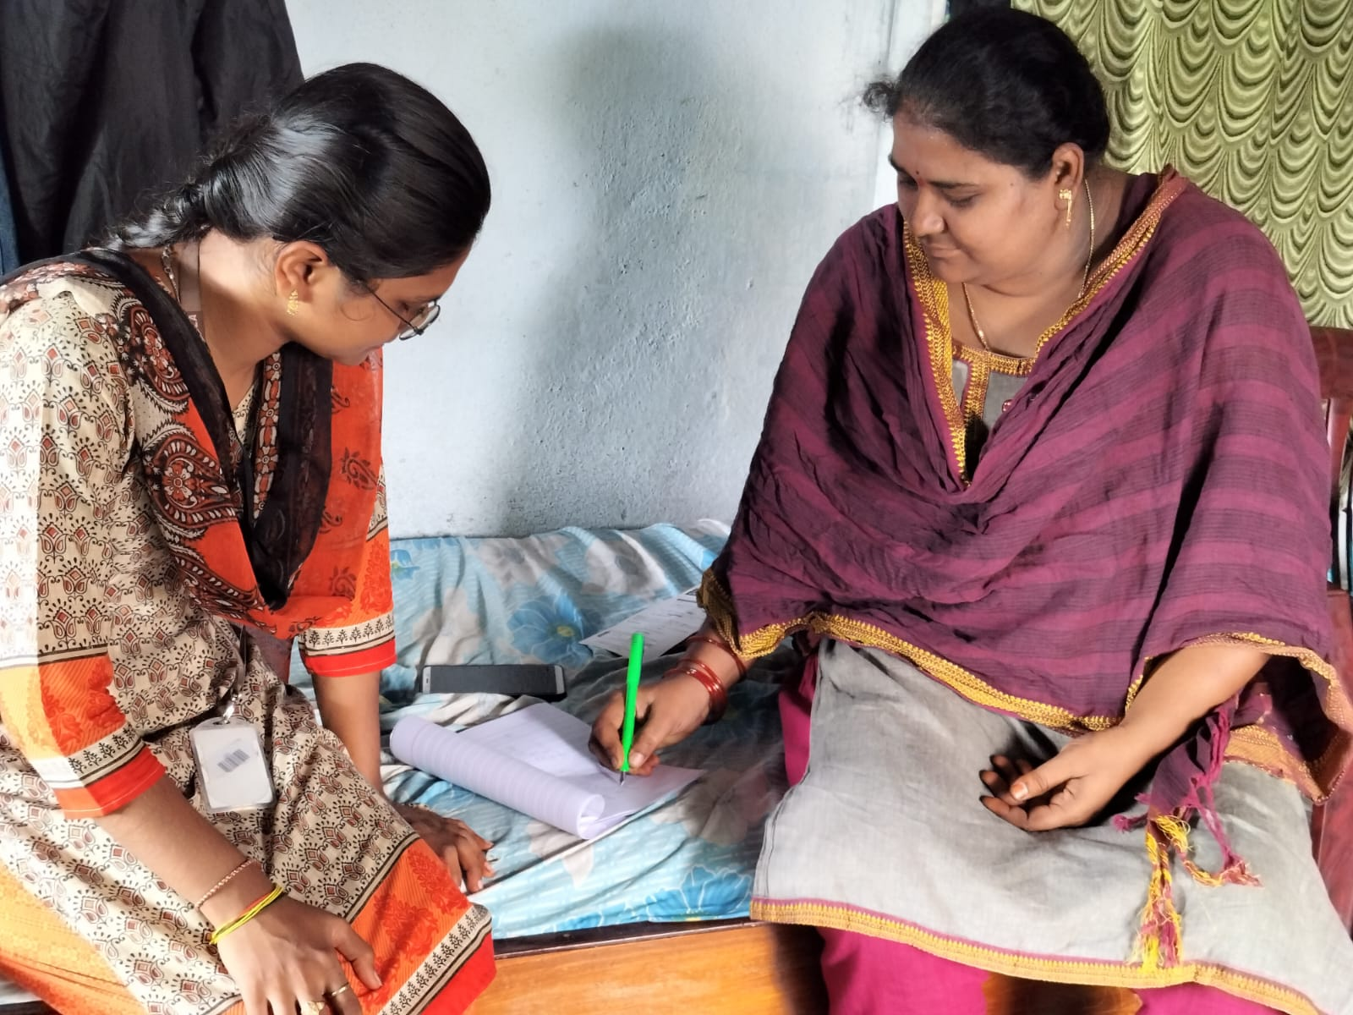

Slide 28
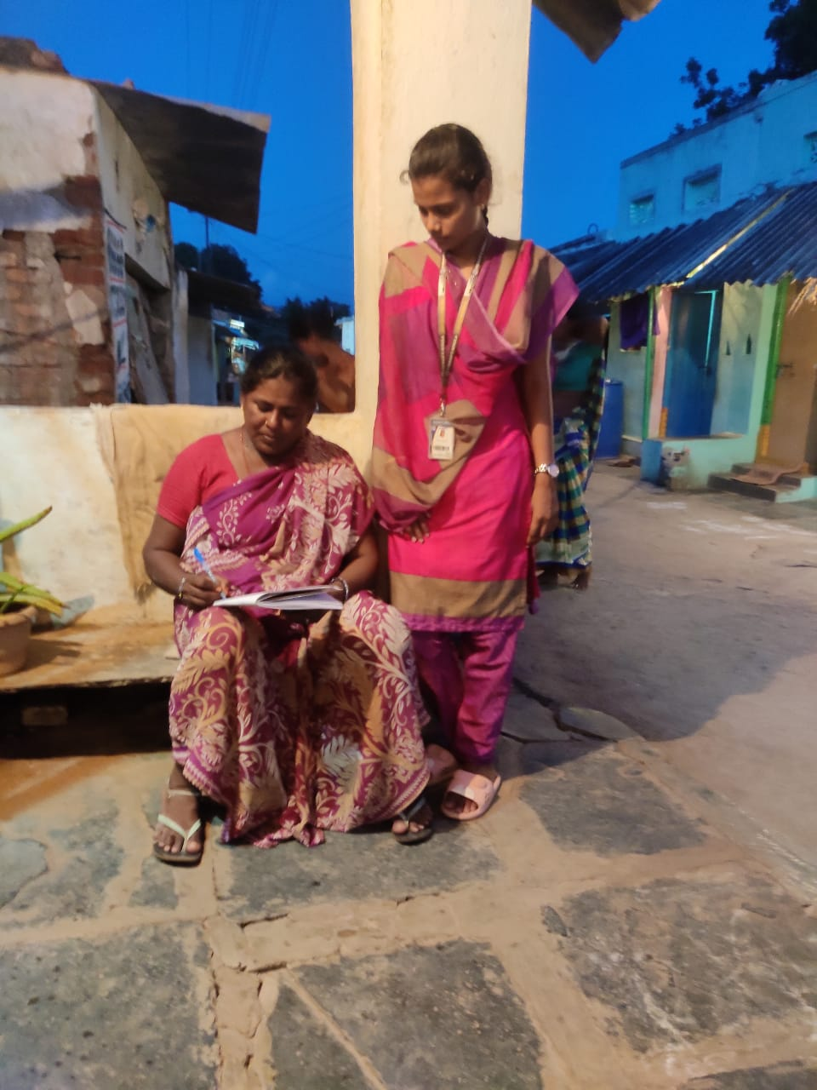
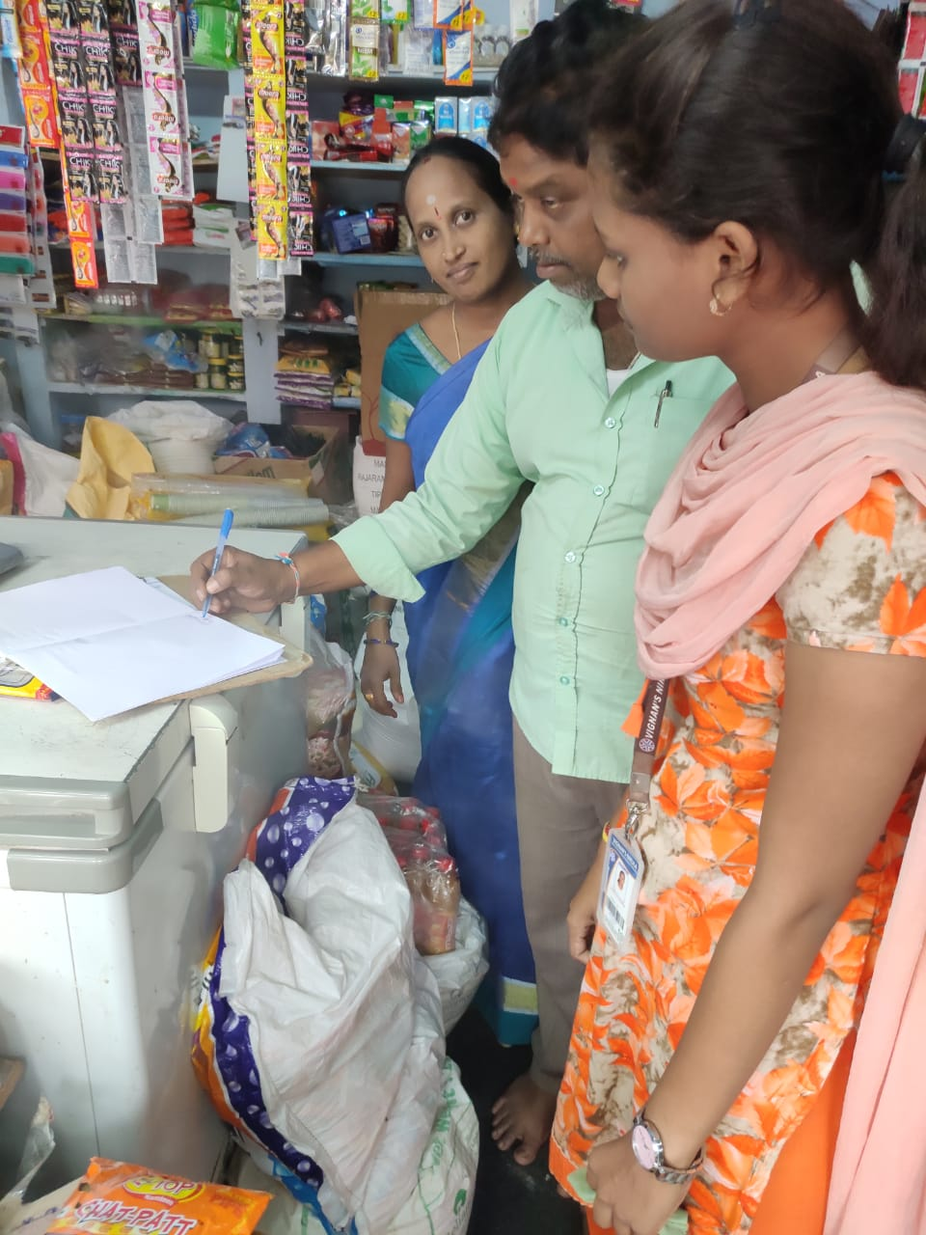

Slide 29
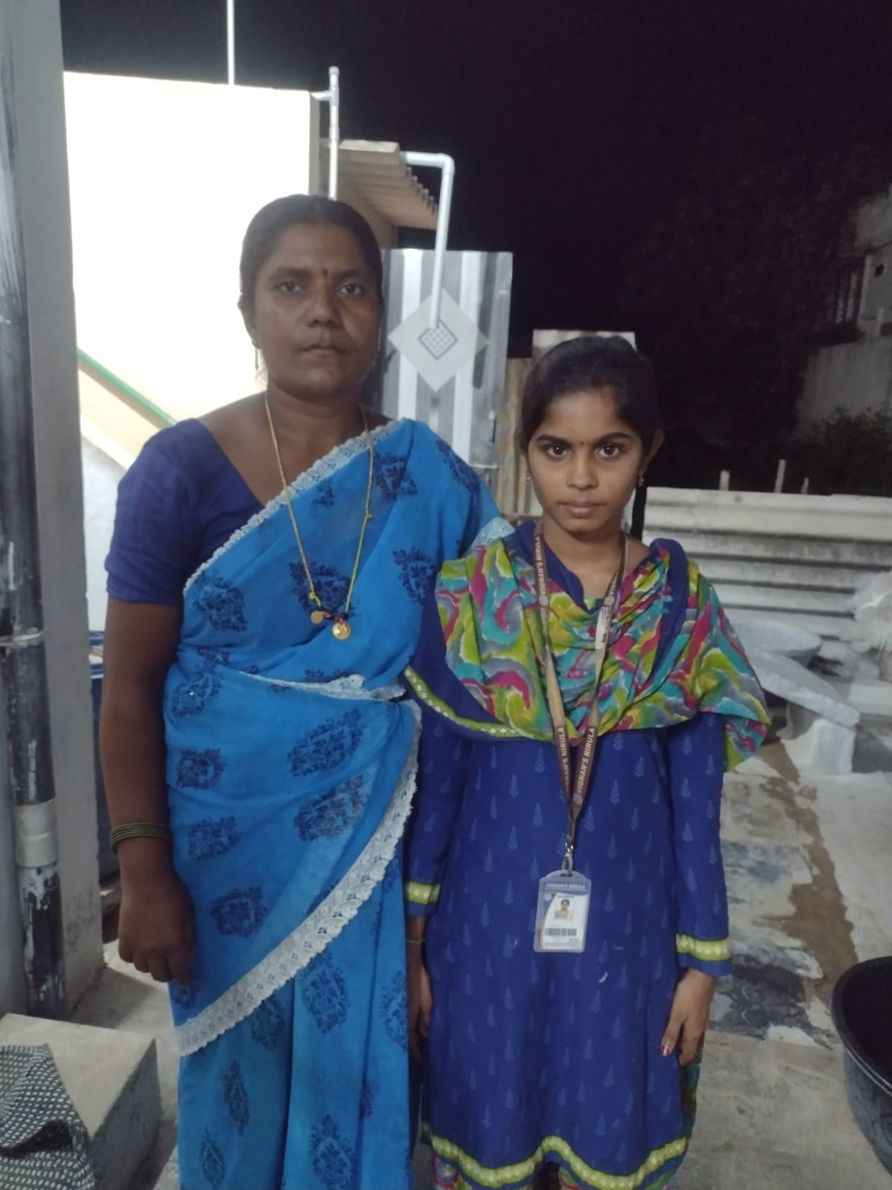
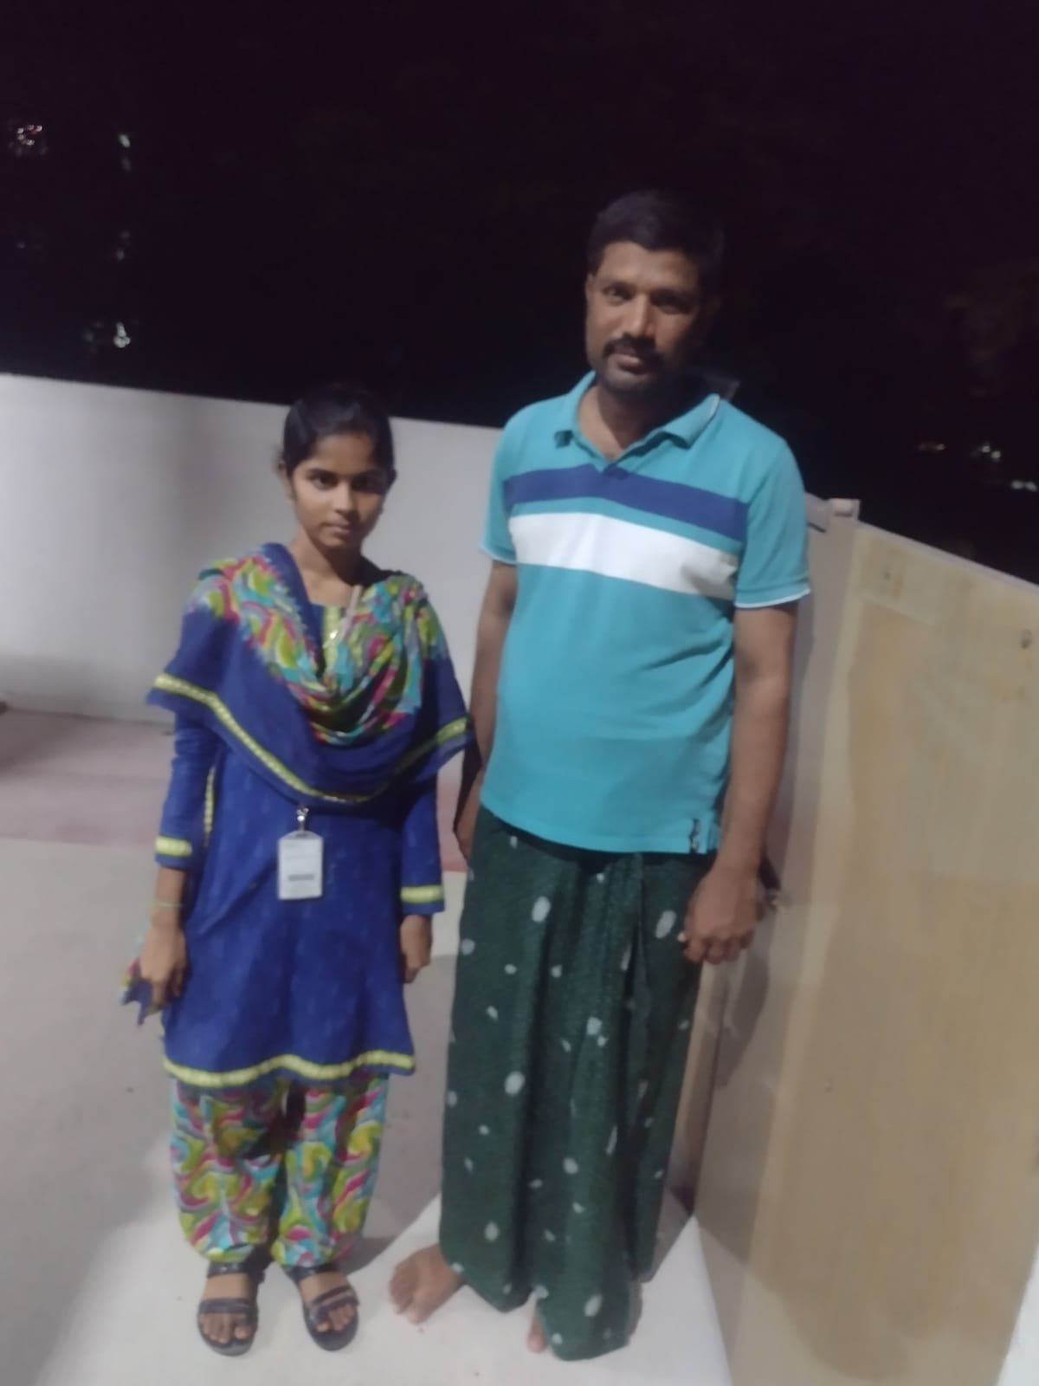

Slide 30
Survey report : Using social media Web sites is among the most common activity of today's children and adolescents. Any Web site that allows social interaction is considered a social media site, including social networking sites such as Facebook, My Space, and Twitter; gaming sites and virtual worlds such as Club Penguin, Second Life, and the Sims; video sites such as YouTube; and blogs. Such sites offer today's youth a portal for entertainment and communication and have grown exponentially in recent years. For this reason, it is important that parents become aware of the nature of social media sites, given that not all of them are healthy environments for children and adolescents. Pediatricians are in a unique position to help families understand these sites and to encourage healthy use and urge parents to monitor for potential problems with cyberbullying, “Facebook depression,” sexting, and exposure to inappropriate content.

Slide 31
I am CHADALAWADA KAVYA of register number 20NN1A1273, belongs to IT department of third year I have done my survey on impact of social media on youth. I observed that the social media has both negative impact and positive impact on youth. There are always two sides of good and bad things, it depends on our perspective how we use it. Social networks started as a place to connect with your friends in an easy an convenient way. Truly speaking, many of you might have found your old friends from school or college who were out of touch due to one reason or other, well I would say I have and I thank social networks for this. Social networks has provided us the opportunity to connect with people and build better relationships with friends with whom we are unable to meet personally, and let them know about our life and take input about their lives and events happening with them. The sharing feature available on the social networks makes your opinion about any topic reach huge number of people Social networks have become a crucial part of many of us. Some people are addicted to social media, throughout their day they feel to post something on their accounts or check other posts as it has become an important part of their life.

Slide 32
I am BOLLA HEMALATHA of register number 20NN1A1272, belongs to IT department of third year I have done my survey on impact of social media on youth.
Social media has become a very important part of life for many young generations in today’s world. There are many young people who keep on engaging themselves with social media without even caring to think about what would be the impact of Social Media on youth. The effects can sometimes be positive and sometimes be negative but mostly they are negative if it is not integrated with a business or professional goal. It acts as a motivation tool from within that nudges you to reach the next and the next step with a positive and happy mind-frame. It is necessary to ingrain this trait in life as an optimistic outlook can help you in leading a constructive life. Positive thinking is immensely powerful as it has the capability to boost the mental, emotional and physical health of a person. It improves the mood, reduces stress and boosts the confidence. When you are feeling upbeat you see the world through glasses. You have an optimistic viewpoint even in adverse conditions that nudge you to achieve your target with immense confidence.

Slide 33
I am Y.ANUPAMA of register number 20NN1A1C8, belongs to IT department of third year I have done my survey on impact of social media on youth.
Using social media Web sites is among the most common activity of today's children and adolescents. Any Web site that allows social interaction is considered a social media site, including social networking sites such as Facebook, MySpace, and Twitter; gaming sites and virtual worlds such as Club Penguin, Second Life, and the Sims; video sites such as YouTube; and blogs. Such sites offer today's youth a portal for entertainment and communication and have grown exponentially in recent years. For this reason, it is important that parents become aware of the nature of social media sites, given that not all of them are healthy environments for children and adolescents. Pediatricians are in a unique position to help families understand these sites and to encourage healthy use and urge parents to monitor for potential problems with cyberbullying, “Facebook depression,” sexting, and exposure to inappropriate content.

Slide 34
I am BATTULA YASASWINI of register number 20NN1A1269, belongs to IT department of third year. I have done my survey on Impact of social media on youth .
Social media refers to all applications and websites or blogs that enable people around the globe to interconnect via the internet, chat, and share content, video call among many other functionalities it offers to its users. For a person to be a member of any social media, he or she has to first signup and then sign in to access content and be able to share and chat with other users of that social media platform. Some of the common and widely used social media platforms include Facebook, Twitter, WhatsApp, Snapchat many among others.Over the past two decades, social media have gained so much growth and fame worldwide to an extent that many researchers are now interested in learning more about these social platforms and their effects on the community. Despite the fact that almost everyone in the community is connected to at least one social media platform, the youth and teenagers are the leading and most fanatic of these social platforms to the point that they even social network while in class or even church. It is to this light that researchers have found that these social sites impact the lives of our youth in a society a great deal in terms of morals, behavior and even education-wise.

Slide 35
Conclusion: As the technology is growing the social media has become the routine for each and every person, peoples are seen addicted with these technology everyday. With different fields its technology everyday. With different fields its impact is different on people. Social media has increased the quality and rate of collaboration for students . Business uses social media to enhance an organization’s performance in various ways such as to accomplish business objectives, increasing annual sales of the organization. Youngsters are seen in contact with these media daily. Social media has various merits but it also has some demerits which affect people negatively. False information can lead the education system to failure, in an organization wrong advertisement will affect the productivity, social media can abuse the society by invading on peoples privacy some useless blogs can influence youth that can become violent and can take some inappropriate actions. Use of the social media is beneficial but it should be used in a limited way without getting addicted Youth need to be taught of the dangers of putting their personal information online , Information that is posted online can never be permanently erased.

Slide 36
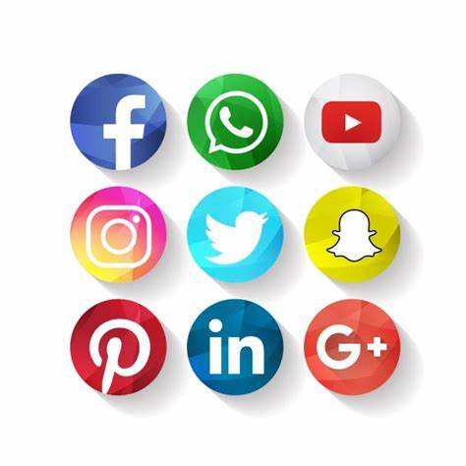
Overall survey views and conclusion of our batch:
In nut-shell, social media is significant part of our lives today. The youth must be able to use their time productively to improve their lives and not squander their valuable time. To be on social media is not a choice today, youth needs to decide how to utilize it to the best of their advantages. In the year 2022 social media is expected to have 3.96 billion users worldwide as per Oberlo, which is 1.1 billion more users than in the year 2017.
Therefore, it can be ascertained from above, that advantages of the social media clearly outweighs its disadvantages. For the youth, seminars, audio-visual tools, group discussions, online reading materials play essential role in shaping their personalities. Social media is a possible amplifier of both risks and paybacks, so the youth must actively and profitably involve themselves in this online ecosystem.

Slide 37
Social media has both positive and negative impacts. Sometimes it is useful but not always . Social media is the one and only platform to gain knowledge. From time to time, we wonder about friends we’ve met along the way and what they’re doing now. Social media is a great way to maintain those connections. Name-search features allow us to reconnect with long-lost friends and network with people we want to get to know better. Through social networking, you have a way to make new friends even if you are the most introverted person on the planet. The gift of relative anonymity on social networking sites allows you to connect with others at deeper levels without being afraid of exposing your true identity. Speeds up communication Through social networking websites, you can communicate faster and more easily. You can reach out to those who are asking for help and can share your thoughts and opinions in discussions in a matter of seconds. Eases loneliness Many of those diagnosed with depression have been in the grips of extreme loneliness. The groups of people who are most susceptible to loneliness include geographically isolated individuals, the infirm, and the elderly.

Slide 38
Promotes social change Younger people are realizing the power of social media for promoting change. The youth have launched numerous campaigns that call their peers to pressure governments and business to become fair, such as exposing corruption, improving educational facilities in their locations, and fighting against gender stereotypes. Support for personal growth Social interactive groups are designed to help you connect with individuals who share your interests. One of the best ways to develop your character is to find a like-minded community that can boost your personal growth. Social media can help you do that. Support for your talent and craft A social site is a place where you can showcase your talents and attract the right audience who can support your craft. Groups allow you to get the feedback you need in order to improve as well as the much-needed support. Sets you on your path as a life-long learner Social media makes it possible to connect with professors, academics, and experts in ways that encourage you to become passionate about learning. It enables you to focus on things that help improve your knowledge base.

Slide 39
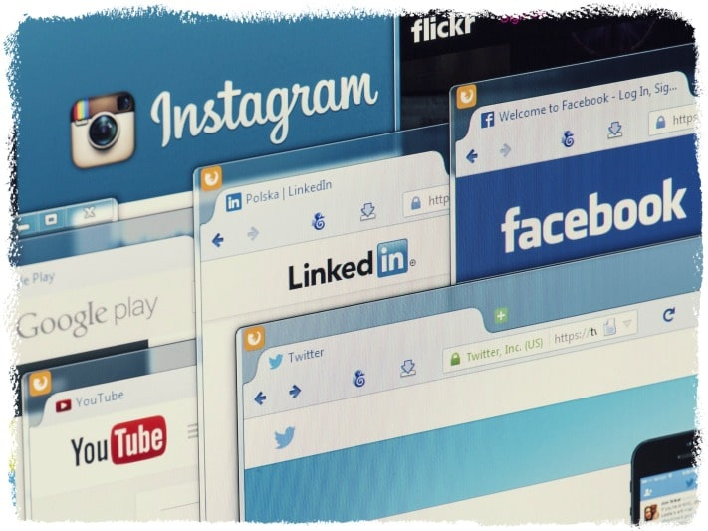
Enables you to become an inspiration Posting about your experiences on the journey to self-discovery can be a source of inspiration to others who are in a similar situation. Your posts can serve as a springboard for others to find hope and the skills to deal with what they are going through. Allows you to have fun Social media, when used in moderation, can provide fun and enjoyment to its users. Social-media apps allow you to keep in touch with friends, uplift your mood, and keep you up to date with what’s happening in your social network.

Slide 40

Today the majority of people uses online social networks not only to stay in contact with friends, but also to find information about relevant topics, or to spread information. While a lot of research has been conducted into opinion formation, only little is known about which factors influence whether a user of online social networks disseminates information or not. To answer this question, we created an agent-based model and simulated message spreading in social networks using a latent-process model. In our model, we varied four different content Social networks play a powerful role and not only influence the formation of opinion of individuals, but can also play a decisive role in political

Slide 41


